Slide 1
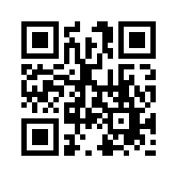
Merritt Scholars
What is the Merritt Scholars Program?
A scholarship and mentorship program to attract young professionals into affordable housing
$10,000 scholarship and mentorship program
How Do You Qualify?
Current undergraduate or graduate student in California
Recommendation by a professor within the Cal Poly or Cal State system, or nominated by an affordable housing professional
Proven interest in affordable housing via coursework, internship, advocacy, or some other way.
Applications Due: April 2024
Questions? Visit https://merrittcap.org/merritt-scholars/
Email MerrittScholars@Merrittcap.org
Register at https://merrittcap.org/merritt-scholars/
or follow the QR Code
Bay Area Cohort at the 2022 NPH Conference

